Slide 1
MovieMagic: The streaming aspect for Cinematography
Presented By:
Jenisha Sthapit
Rusha Manandhar

Slide 2
Introduction
A revolutionary movie streaming platform offering affordability, quality, and accessibility.

Slide 3
Problem Statement
Streaming Quality and Offline Viewing
High Subscription Costs
Advertisements and Interruptions

Slide 4
Objectives:
Enhance user experience with HD streaming, community engagement, and data security.

Slide 5
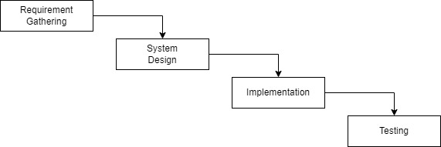
Methodology:

Slide 6
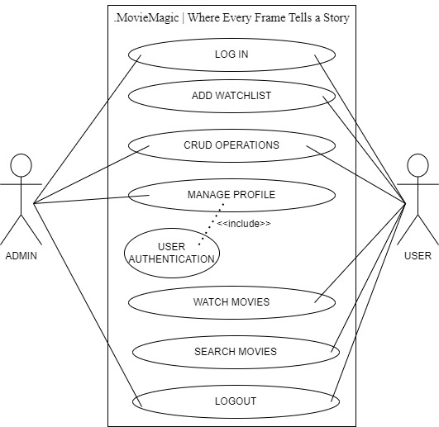
Use Case:

Slide 7
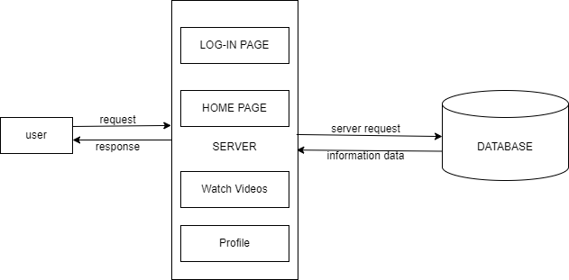
Architectural Diagram:

Slide 8
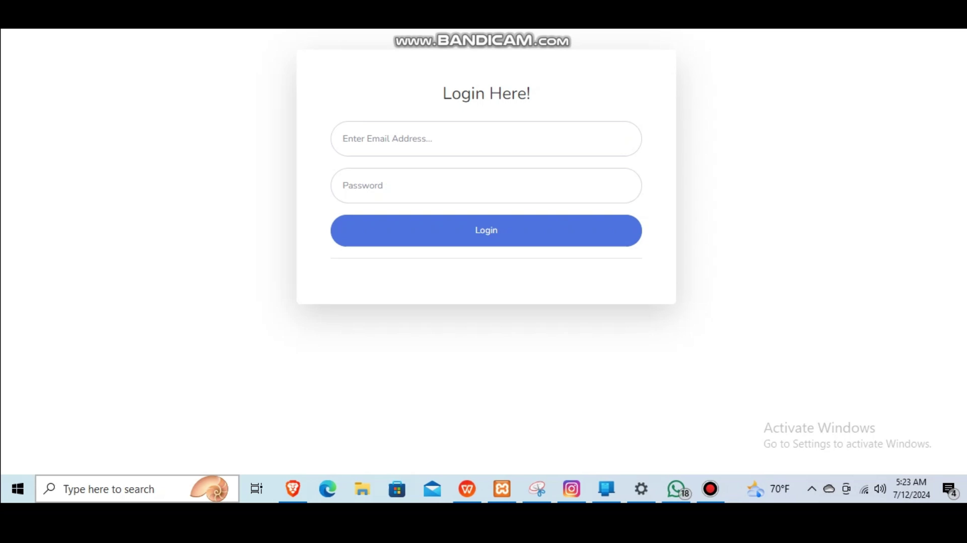
Demo Video:

Slide 9
Conclusion:
Improved user experience. Enhanced engagement and features. Continuous improvement ahead.

